Slide 1
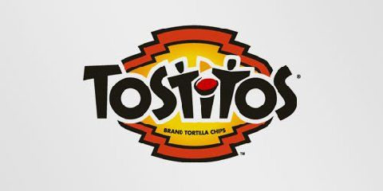
If you look at the center of this logo, you can see two people enjoying a Tostito chip with a bowl of salsa. This logo conveys an idea of people connecting with each other.

Slide 2
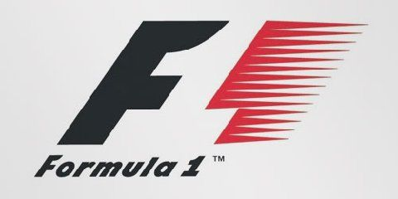
At first, this logo might not make much sense. But if you look closely, you'll see the number 1 in the negative space between the F and the red stripes. This logo communicates a feeling of speed.

Slide 3
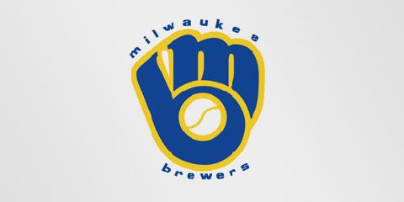
The Milwaukee Brewers is a professional baseball team from Milwaukee ,Wisconsin . Their logo is made up of the letters M (on top) and B (below the m). These two letters also form a baseball glove.

Slide 4
There is a forward arrow in the FedEx logo. Do you see it?

Slide 5
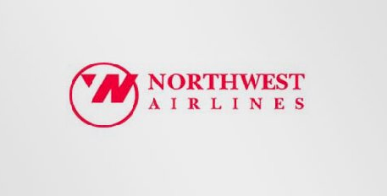
This simple looking logo actually carries a lot of information. First of all you can see the letters N and W, the first two letters of the brand name. But what most people don't see is the compass that points to the Northwest, another reference to the brand name.

Slide 6
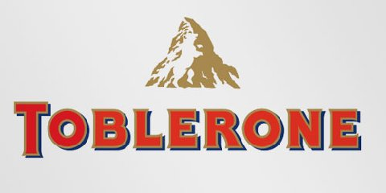
Toblerone is a chocolate-company from Bern , Switzerland. Bern is sometimes called 'The City Of Bears'. They have incorporated this idea in the Toblerone logo, because if you look closely, you'll see the silhouette of a bear.

Slide 7
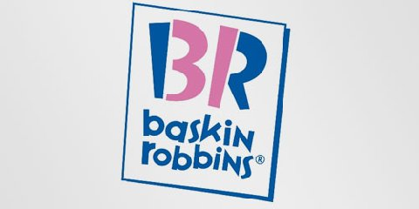
The old logo of Baskin Robbins had the number 31 with an arc above it. The new logo took this idea to the next level. The pink parts of the BR still form the number 31, a reference to the 31 flavors.

Slide 8
QUIZ

